Slide 1
BAMBUI CULTURAL COMMUNITY
BACCO USA INC.
HOSPITAL Solar Project

Slide 2
THE COMMUNITY
A population of about 150,000 people
Supporting Bambui and neighboring villages Bambili/Bafut/Babanki/Nkwen
You can make a difference, YES YOU CAN

Slide 3
Projects realized
Tubah hospital toilet 2017
Tubah hospital bolehole 2018
Mallam hospital renovation and pharmacy supplies ( medications) 2019
Street s

Slide 4
TOILETs PROJECT
Contraction of toilets
Connection of water

Slide 5
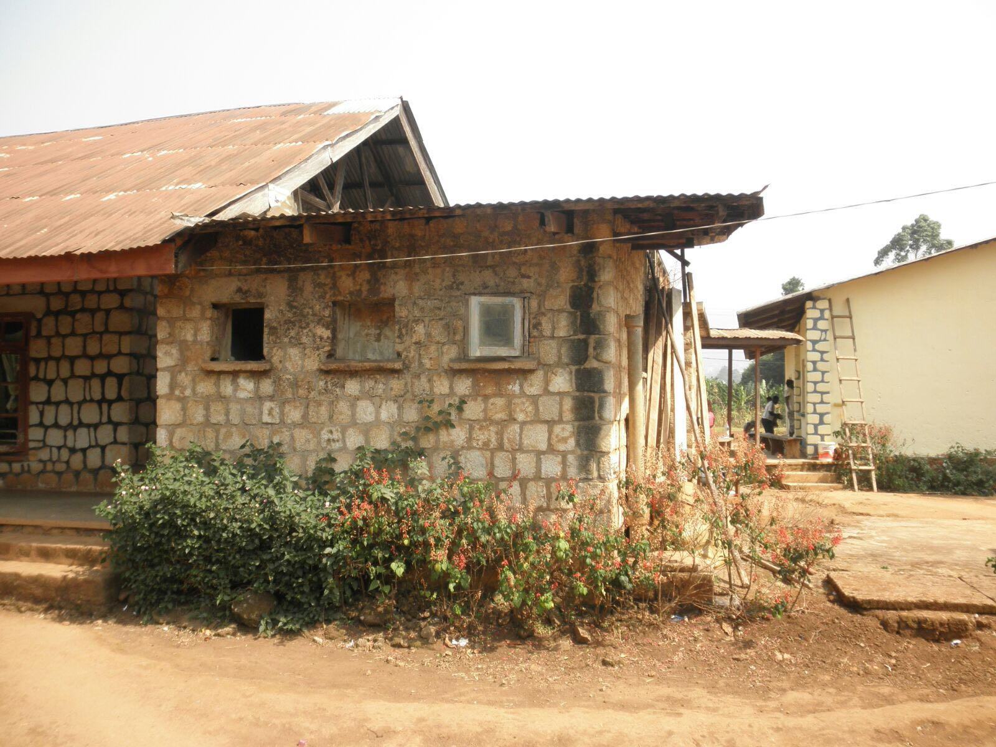
CONDITION OF HOSPITAL TOILET BEFORE THE PROJECT
The Hospital

Slide 6
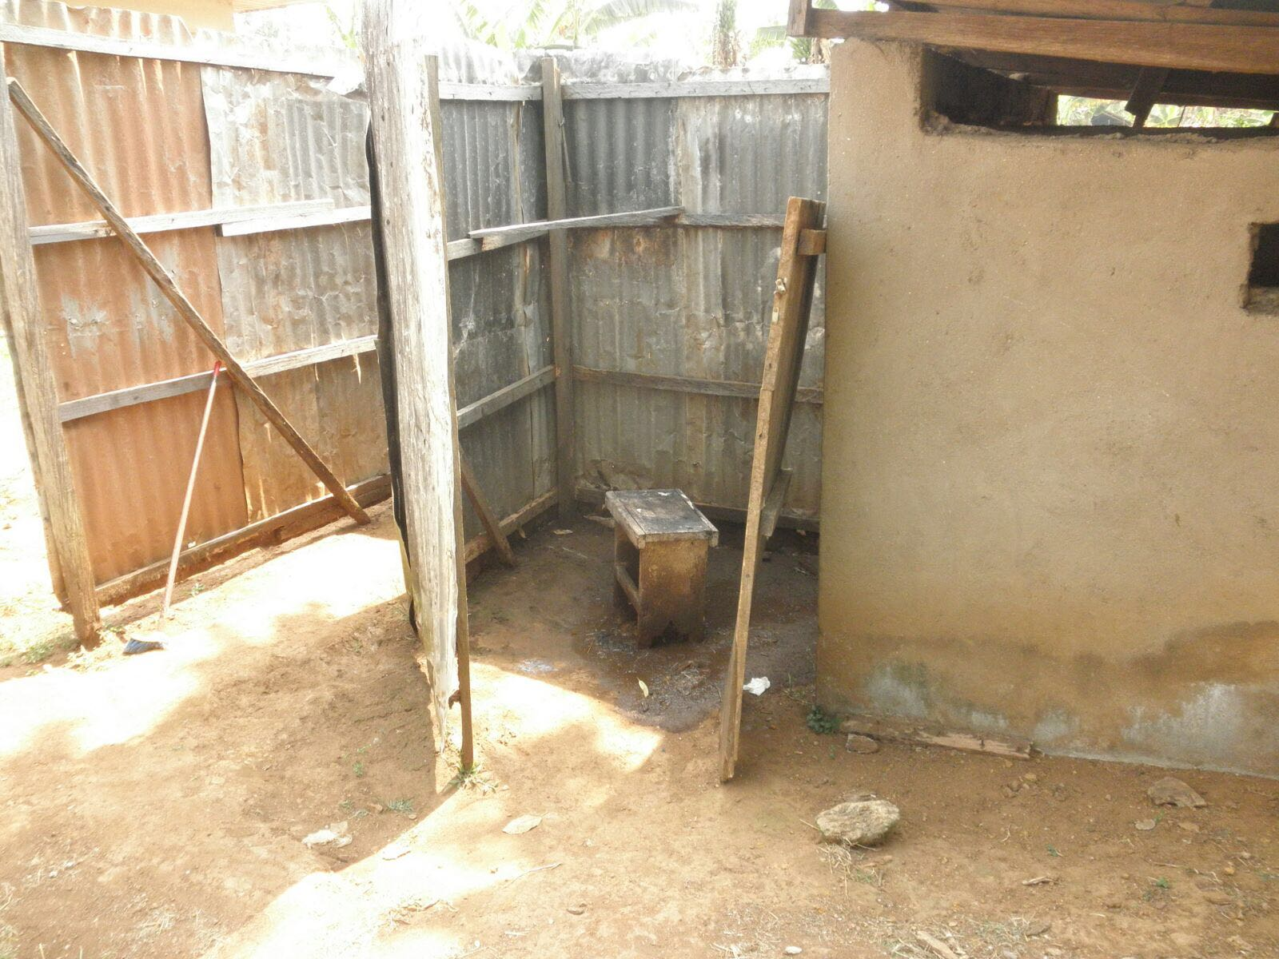
The toilets
Certainly can’t do much to improve health

Slide 7
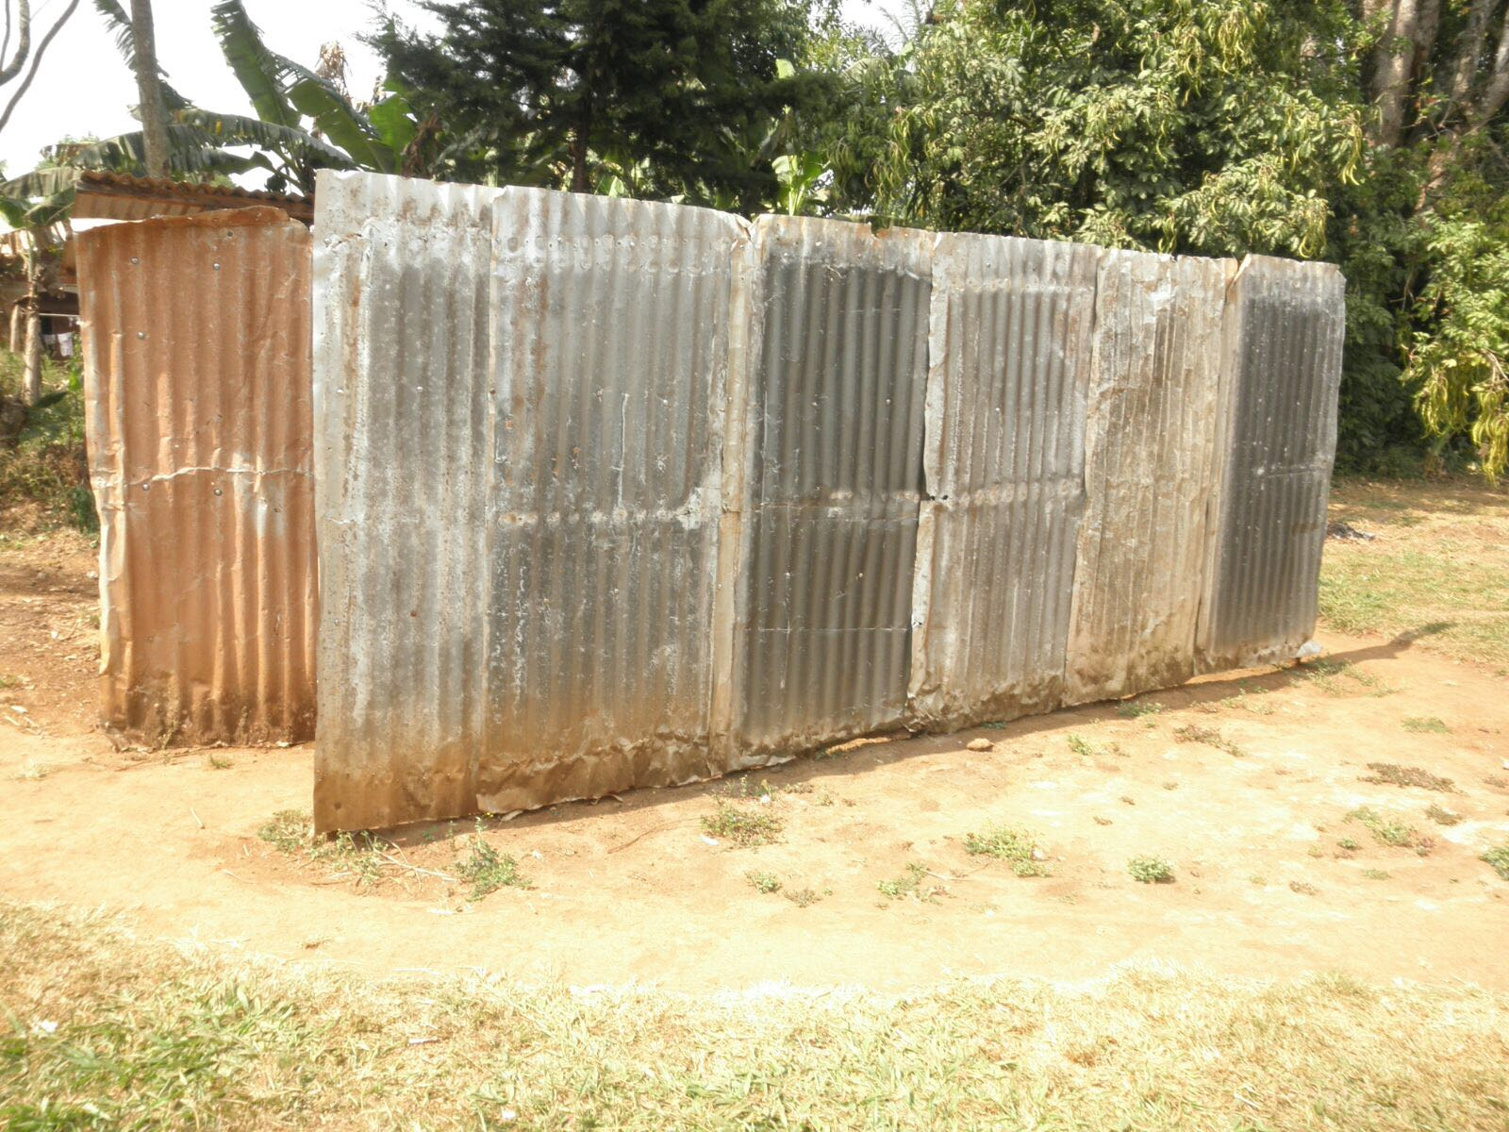
The Bath!!!!!!!
It certainly can be better

Slide 8
Toilet Construction
CONTSTRUCTION OF THE STRUCTURE
MODERNIZATION OF THE TOILETS

Slide 9
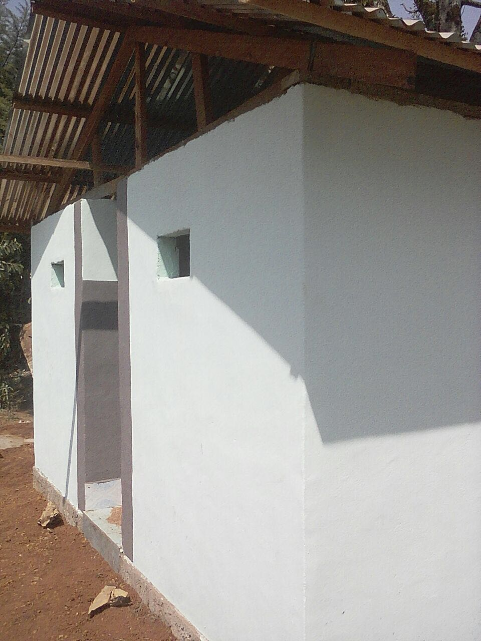

Slide 10
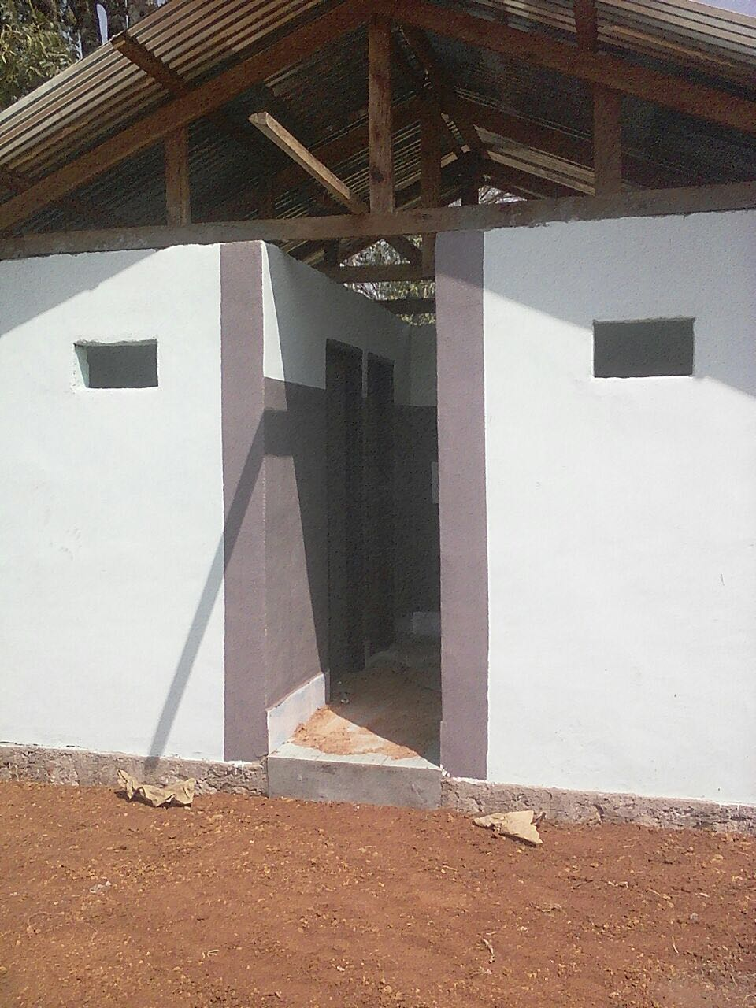

Slide 11
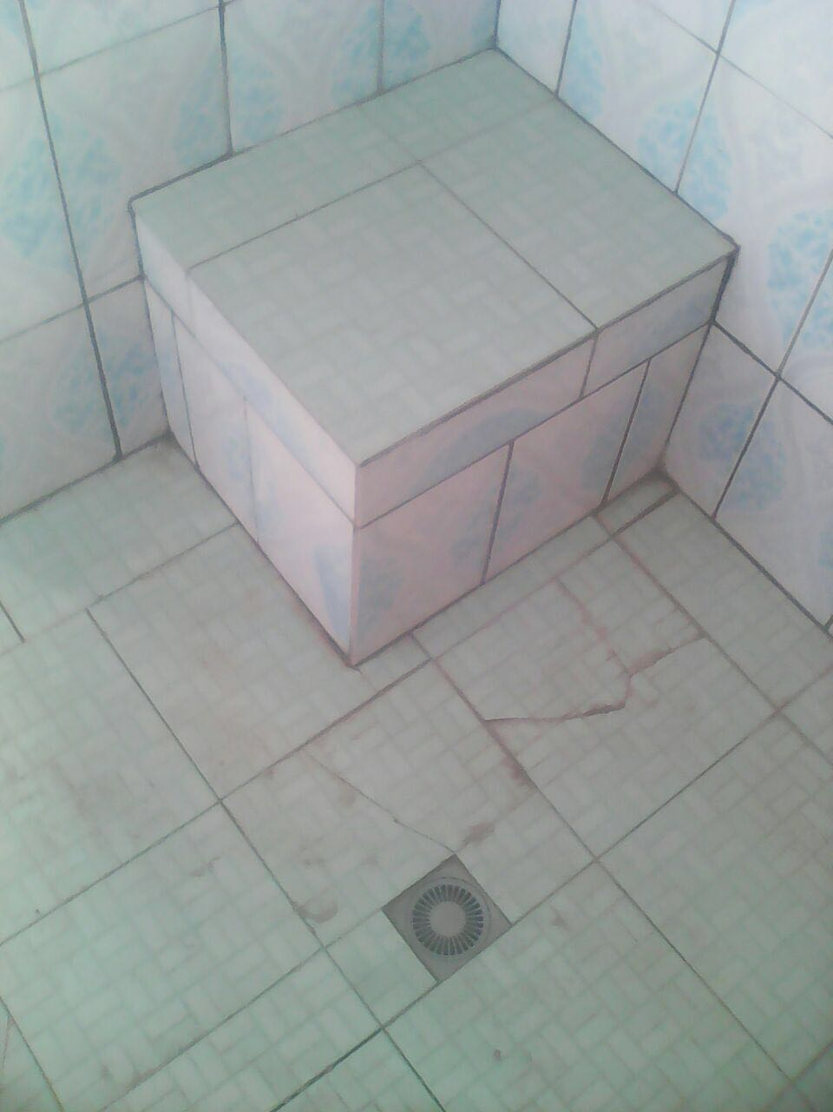

Slide 12
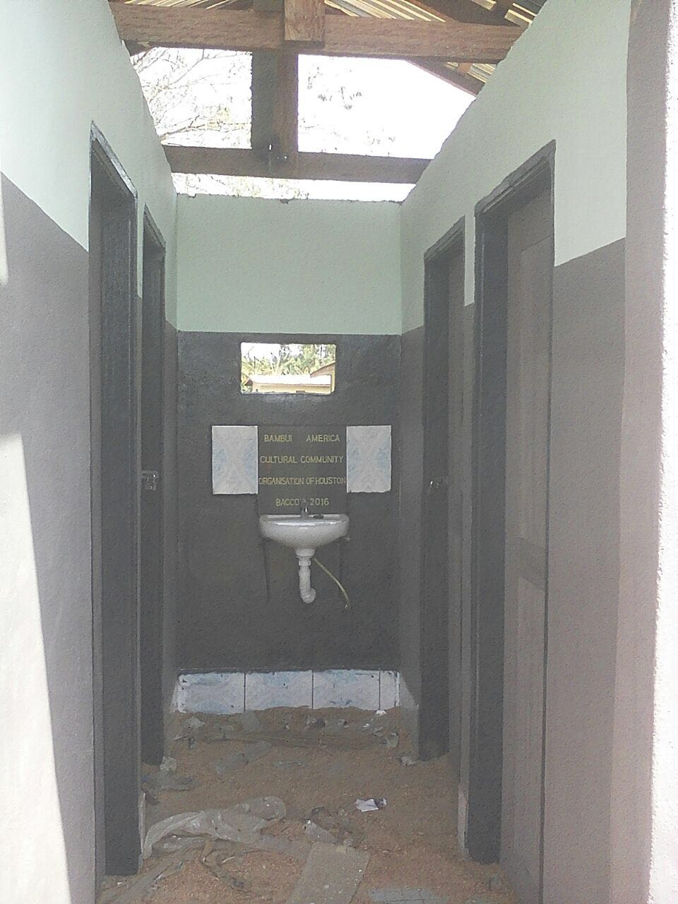
Above all, hook up water and get the toilets and bathrooms operational
Complete the construction

Slide 13
Before
Now
The good news is…
Thanks to BACCO USA, our people can now get some relief

Slide 14
Borehole Project
INSTALLATION OF MOTOR PUMP
CONSTRUCTION AND INSTALLATION OF 2500 LITTERS TANK
CONNECTION OF PIPE TO TOILETS AND STAND TAPS

Slide 15
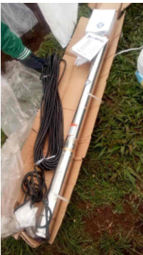
Forbah

Slide 16
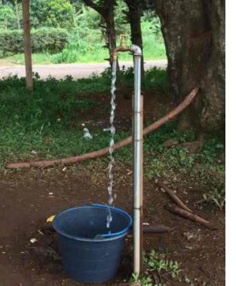

Slide 17
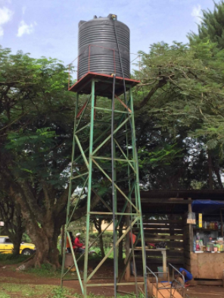

Slide 18
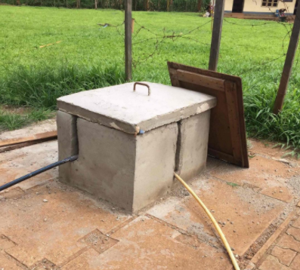

Slide 19
PHASE THREE
Pharmacy Medical Supplies Mallam Clinic
Construction of a Toilet at the Mallam Clinic

Slide 20
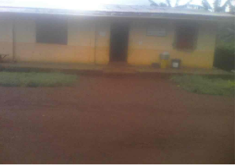
Present condition of the Mallam Clinic

Slide 21
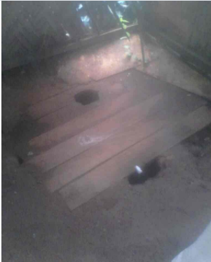
TOILETS

Slide 22
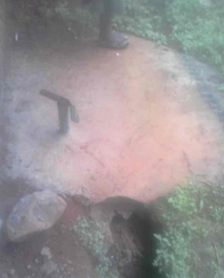
BATHROOMS

Slide 23
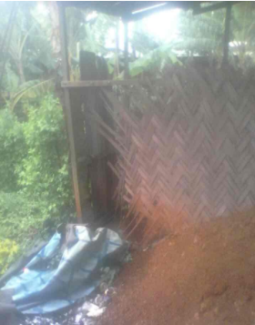

Slide 24
Great job BACCO
We’ve come a long way
But it’s not over yet!!!!!!
A little more and we’ll be there!!!!!!

Slide 25
PRESNT PROJECT
ENHANCING THE ELECTRICAL SYSTEM IN BAMBUI COMMUNITY
Building a sola rsystem
Installing streets lamps

Slide 26
PHASE ONE
Installation of street solar lights

Slide 27
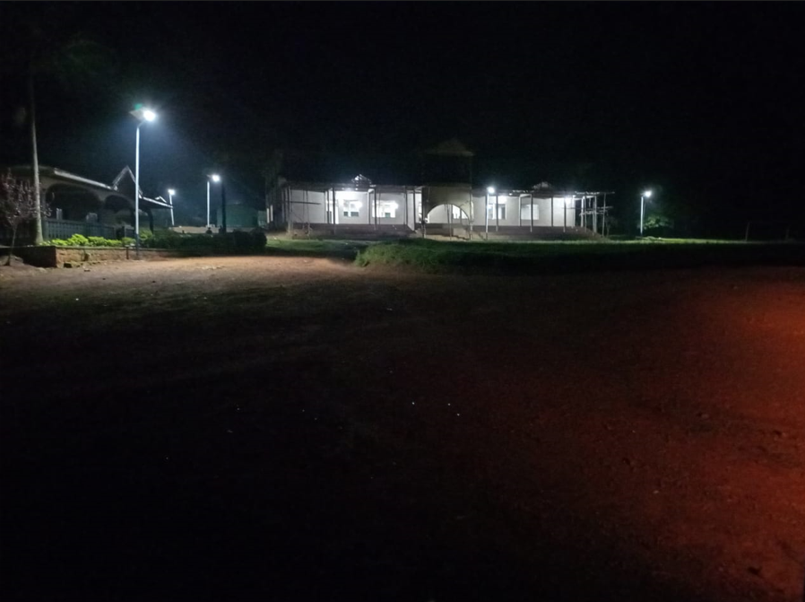
Solar Street light

Slide 28
PHASE TWO
Installation of solar PANNELS
Installation of batteries
Connection to facility

Slide 29
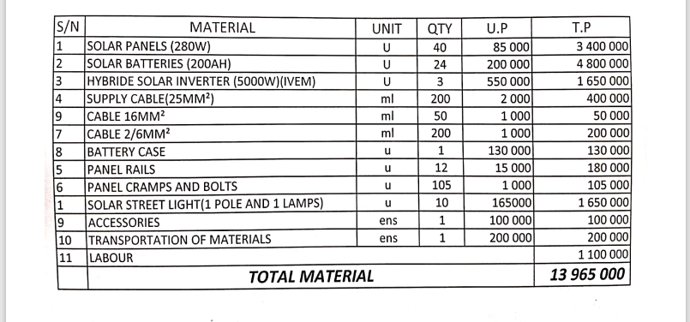
Estimate

Slide 30
Let’s go the extra mile
Let’s finish up what we started
Let’s give our money its full value

Slide 31
TO DO LIST
1 – SUPPLY LIGHT (SOLAR)TO HOSPITAL AND BAMBUI VILAGE MESEUM
Construct an engineering Solar system
Installation Street Lights

Slide 32
TARGET
$ 30000

Slide 33
Thanks for your keen attention
and
Your anticipated contributions

